Slide 1

New Horizons in Peer Advice Systems: Developing Freelance Advisor
Dr Holly Patrick-Thomson
Dr Paul Lapok
A/Prof Alistair Lawson

Slide 2

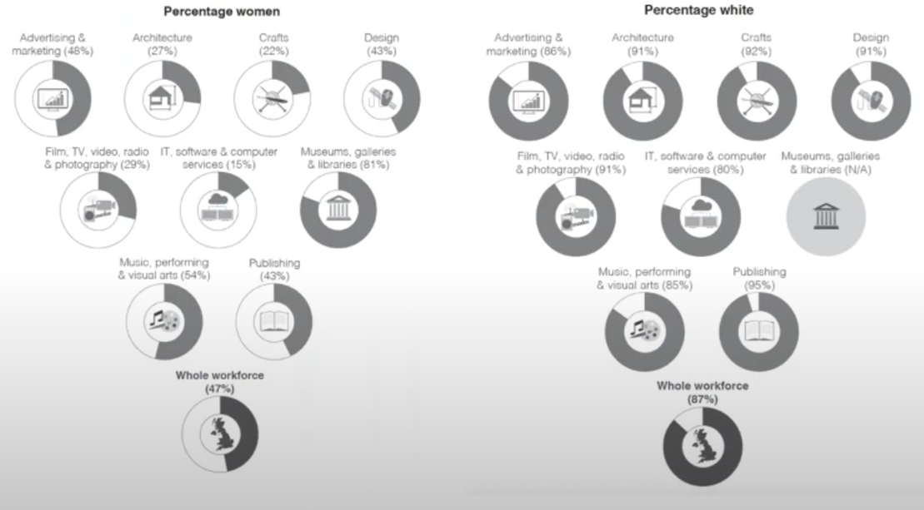


Context
Passion (McRobbie, 2018)
Autonomy (Smith and McKinlay, 2009)
Desirable (Bourdieu, 1984)
Poorly paid (Siebert and Wilson, 2013)
Insecure (de Peuter, 2011)
Hard to access (Brook, O’Brien and Taylor, 2020)
Notes:
Work in the creative and cultural industries is often seen as “good” because it offers people a chance to earn money while engaged in their passion (McRobbie, 2018), to have autonomy over when, where and how they work (Smith and McKinlay, 2009), and because it is seen as a desirable occupation (Bourdieu, 1984; Brook, O’Brien and Taylor, 2020). However, extensive research by these same authors shows that creative work is often poorly paid, insecure and hard to access. This is exacerbated for those who come from working class backgrounds, who are of BAME heritage, and are new to the sector (Brook et al, 2020). Aside from institutional factors, this inequality can be traced to the lack of networks that these groups may have within the arts, and how this impedes their ability to access valuable advice on their careers.
The creative industries are notoriously difficult to break into, and learning the ropes is key. Over 30% of the creative industries workforce is self-employed, as opposed to ~15% in the broader UK economy, and these ‘creative freelancers’ (such as actors, photographers and singers) often lack access to advice on how to progress in their careers.

Slide 3

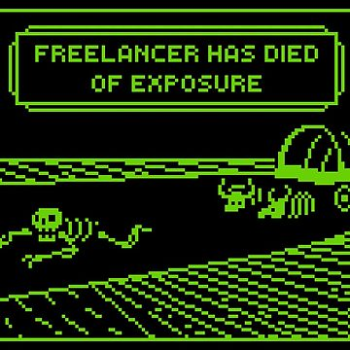
Importance of Peer Advice to Creative Freelancers
56% of creative freelancers do not feel well informed of their rights (Mc Connell et al, 2022)
57% rely on online peer communities (such as Facebook groups) to solve issues relating to contract negotiations and ‘grey issues’ not easily resolved by a quick internet search, such as setting rates (Connell et al, 2022; Patrick-Thomson and Kranert, 2021)
However, this form of advice system is flawed:
  Finding the right communities
  Assessing trustworthiness/ usefulness of advice
  Limited efficiency of forums in providing advice
Notes:
There is a large information asymmetry between creative freelancers and their clients, EXPLAIN
There is a clear demand for advice, which forums are partially but not completely meeting. While a patchwork of unions, other worker collectives (such as studios), professional associations and NGOs provide support for freelancers, a tool which better enabled the collection and provision of peer advice would be valuable in helping CFs to approach common contractual issues. AI systems may provide opportunities to gather, digest and disseminate peer advice, helping to overcome some of the issues of forums and other sources of advice provision. But what are the most common contractual issues? How best to tackle them using an AI tool? Would such a tool be used by freelancers and if so, then how?

Slide 4
Literature
Work/Employment advice can have both task-interactive and personal interactive aspects (Bennet and Robson, 2004) - e.g. what to charge for job x vs how to approach a discussion about fees with a new client
Accessing good advice can have a positive impact on performance, satisfaction, work attitudes and reduce stress and turnover in organisations (Ostroff and Kozlowski, 1992)
Less research in freelance setting, but some studies suggest informal peer advice is very important to small business owners (Fishcher and Reuber, 2003)
Effective advice giving/seeking often relies on an existing relationship between the parties (Bennet and Robson, 2004), and context specific ‘deep’ knowledge more useful than broad (Mole, Hart, Roper and Saal, 2011)
While literature has traditionally focussed on local networks, there is increasing evidence of the importance of online networks (Ring et al, 2010; Kuhn, Galloway and Collins-Williams, 2015, Kuhn and Galloway, 2015, Patrick-Thomson and Kranert, 2021) – Perhaps due to the benefit of weak ties for providing novel advice (Granovetter, 2018 [1985])
However, professional online forums are under-researched or mainly viewed as means of information distribution (Garzone 2016)
Notes:
Therefore, while the literature suggests that online networks may be growing in popularity and usefulness for freelancers, we do not know whether this applies to creative freelancers.
This research seeks to add to the literature by exploring the nature of knowledge gaps and knowledge sharing by creative freelancers, specifically focussing on the informal peer exchange of business advice, specifically, what ar ethe most common contractual issues faced by creative freelancers and how do they seek advice on these issues (from their peers and more generally).

Slide 5

Project Vision
To develop a tool that enables creative freelancers to access the nuanced, trusted peer advice that is typically available only to those with established networks or existing experience
Technical
Interactive
User Facing
Scoping system parameters and demands
Developing a set of scenarios regarding system parameters (e.g. functions, use cases)
Initial (LoFi) prototyping
Stakeholder Mapping
User testing and refinement
HiFi design prototyping
Front end build
Extended user testing
Database establishment
Advisory
Group Est.
A.I. feature prototyping
Back end build
System Integration
Establishing
Governance
Final user testing
Freelance Advisor Launch

Slide 6
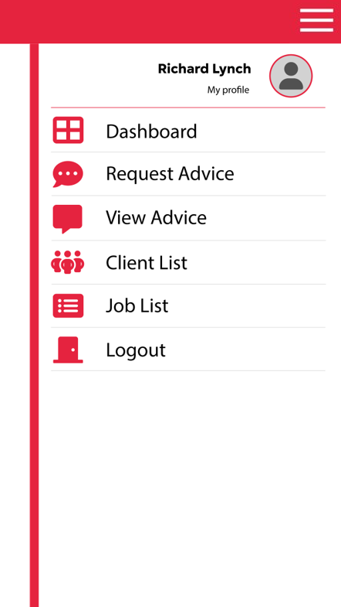
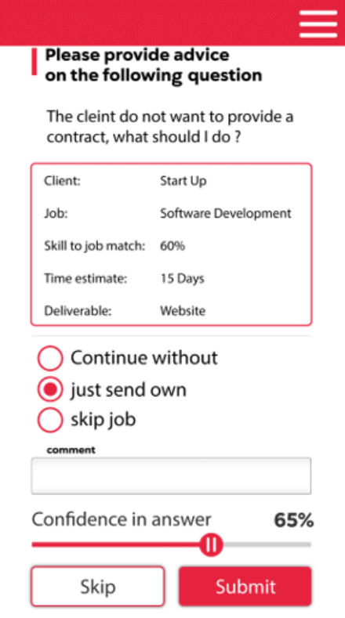
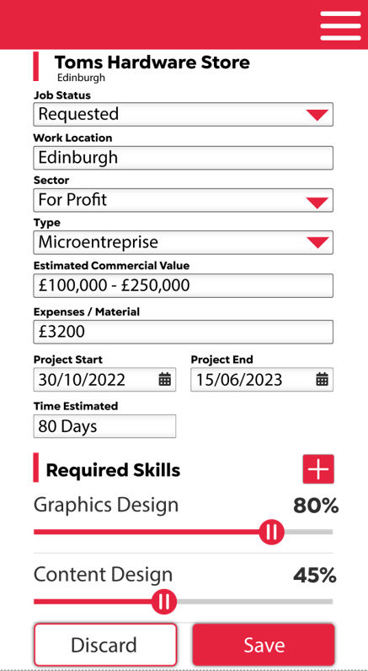
Notes:
I think there is a paper in here about peer-advice practices of freelancers – but unsure if there is another angle to explore.
Also keen to see if anyone has experience of app building or in general of getting funding to support non-commercial applications of research.

Slide 7
Insights Derived from Project to Date
Hard to get advice on the softer side of negotiations (e.g. “How much is it rude to ask people for”)
Networks mature with experience, but those newer in the industries do not know who to ask or sometimes even how to ask
Freelancers find information on ‘going rates’ very helpful, but it isn’t available at present
In-depth advice on relational issues from those with appropriate experience is particularly valued
Trust and anonymity are important in exchanging advice
  Advice is only valuable if it comes from a place of superior knowledge/experience/insight – therefore the credentials of the advisor are important
  In-depth, relational advice is what is needed, but advisees can be reticent to provide the necessary information to generate such advice, outside of their circle (due to the risk of being identified and potential reputational damage as a result) - therefore it is important that queries can be made in confidence or that are not immediately identifiable
  Personal recommendations were an important indicator of forum reliability, so having trusted figures and organisations within the CIs recommending the advisor may be key to uptake
One factor that frustrates advice searches/provision is that many creative specialisms are highly specific, yet…
Despite significant differences in how work is contracted and paid across creative sectors, cross-sector peer advice is seen as useful (both in devising prices and in justifying them to clients)
Understanding the value others place on advice helps newcomers to interpret it - A ranking function would help (c.f. e.g. Quora)
Notes:
On trustworthy advice:
‘Interviewer: Why would you be more likely to go to your peers first? Or to consider that my advice more valuable than through a Facebook group?
Participant 4: Uh, because they often overestimate the amount the strength to which they know things to be true… and people generally might universalize their own experiences when they're not universal.
I mean you see this like tons over the course of the pandemic, right? I remember someone really adamantly going on everyone’s Twitter and saying that if you drank wine after you've got the vaccine, it wouldn't work, which is just like demonstrably untrue. But there was so convinced that it was true. So yes, I'm I guess the last couple years we've made me so much less likely to take random people’s advice’.
Importance of anonymity:
Encouragingly for the prospect of chatbot development, a few participants noted that they would be reticent to actively seek advice on a public forum, but would be happy to do so anonymously: ‘I think I'd feel really uncomfortable putting my name to a question about finances on something like that. I would happily ask it anonymously’. When asked why they would not feel comfortable, they explained:
‘It goes back to like, not ever having been taught it or there not being a set structure as to what that expectation is. And so you sort of feel like if you've been in business this long, you should know. And like you don't want to ask those questions’.
As well as giving hints as to the experience underpinning the advice, credentials also inform how advice will be interpreted – e.g. if someone is from a different sector then their advice may provide a useful external perspective, but only if the advisee knows that they are from another sector. All of this is not easy to achieve on the existing online forums
Going rates for different employers, for sectors, for different types of work and difference experience levels.
On specificity:
The issue of advice often being too general was obviously a bigger problem for those freelancers who occupied a niche, as explained by the cross-sector researcher:
‘Yes, when you don’t fit into a specific box, or your specialism is a niche, that can be a gift but it’s also frustrating when you’re starting out. You almost need a beginners guide to help you figure it out. When trying to work out terms for payment and the letter of engagement and what it looks like; some places will offer templates, but trying to find one that is good for research services was hard.’

Slide 8
Broader Implications of Freelance Advisor
Will be the first live, worker-fed database on the working conditions of creative freelancers:
Going rates
Patterns of employment
Key skills (gaps)
Equalities issues
Addresses a deficit in policy makers knowledge (DCMS, 2023) which necessitates a deficit in policy making (Public Campaign for the Arts, 2024)

Slide 9
Questions and Challenges
Ownership and governance – Choosing a vehicle to own the app
Converting an impact-led project into academic publications
Collaborating without problematising IP

