Slide 1
Leading with Bricks Research and Learning Showcase Day – 19 June 2019

Slide 2
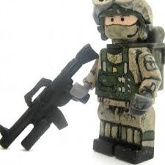
Building a case in entrepreneurial leadership
Background:
MoD contract serving three services
Transitioning from military service into entrepreneurship
Outputs:
Increase awareness of entrepreneurial approaches for individuals
Signpost to support for business start-up eg Bright Red Triangle
Podcasts
Teaching and Learning cases

Slide 3
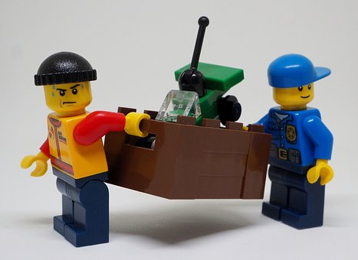
Pedagogical approaches
Active Learning
Storytelling
Serious Play
Metaphor
Case studies

Slide 4
By the end, we hope you will be able to:
Develop understanding and practice of building a case study through active learning
‘Have a go’ at building
Explore problem solving through play
Enhance active learning practice

Slide 5
Three-phase play process
Building to stimulate new ideas
Storytelling to share meaning
Collaborative approaches to problem solving
After Roos, J. and Victor, B., (1999), Towards a new model of strategy-making as serious play, European Management Journal, 17(4), pp.348-355.

Slide 6
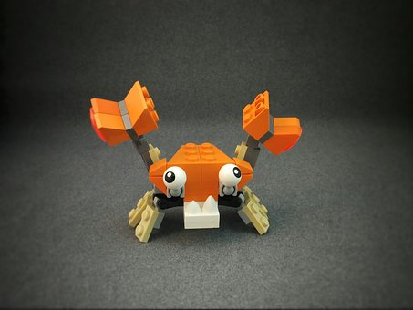
Build
LEGO® SERIOUS PLAY®
Have a go …
Build you
Introduce yourself to the group

Slide 7
Problem solving
In your groups, produce a model/metaphor that represents one of the sector challenges described on the following slide.
Why not place a photo of your model on Edinburgh Napier workplace?
Why not tweet a photo of your model?
@ #

Slide 8
Challenges
How can the HE sector lead on:
tackling retention?
developing the Workforce of the Future?
building digital skills?
reducing the gender gap?

