Slide 1
Scottish Policing 2011
–
Risks To Communities &
Information-Sharing
Russell Scott
Visiting Academic
Edinburgh Napier University
Serious Organised Crime and Information/Intelligence Sharing
Omair Uthmani
Research Student
Edinburgh Napier University
Notes:
Context:
Need for effective communication between Police and Community Partners: Social Care, Health Care, Education

Slide 2
Business Model
Risk – Identify and managing risks to ensure a balanced approach to operational management and organisational development
Resources – Balancing the disposition of limited resources to meet the priorities
Results (outcomes) – Balancing the needs of citizens with quality service delivery to the satisfaction of customers and key stakeholders
. This workshop forms part of research, funded by the Scottish Institute for Policing Research (SIPR), to develop a process for formalising policy using a scientific approach to define information sharing agreements. It aims to critically appraise existing and new methods of policy interpretation, review and implementation, against a relevant example scenario.
Notes:
Context:
Need for effective communication between Police and Community Partners: Social Care, Health Care, Education

Slide 3
Key Risks – Operational
Serious Organised Crime Groups
Terrorism
Violence
Public Protection
Antisocial Behaviour
. This workshop forms part of research, funded by the Scottish Institute for Policing Research (SIPR), to develop a process for formalising policy using a scientific approach to define information sharing agreements. It aims to critically appraise existing and new methods of policy interpretation, review and implementation, against a relevant example scenario.
Notes:
Context:
Need for effective communication between Police and Community Partners: Social Care, Health Care, Education

Slide 4
Key Risks – Business
Finance and Collaboration-Including Partnerships
People-Including Training
Assets- Including Information Management
Performance-Including Targets
. This workshop forms part of research, funded by the Scottish Institute for Policing Research (SIPR), to develop a process for formalising policy using a scientific approach to define information sharing agreements. It aims to critically appraise existing and new methods of policy interpretation, review and implementation, against a relevant example scenario.
Notes:
Context:
Need for effective communication between Police and Community Partners: Social Care, Health Care, Education

Slide 5
Cybercrime
UK National Security Strategy
Scottish Policing Assessment
ACPOS E-Crime Strategy
. This workshop forms part of research, funded by the Scottish Institute for Policing Research (SIPR), to develop a process for formalising policy using a scientific approach to define information sharing agreements. It aims to critically appraise existing and new methods of policy interpretation, review and implementation, against a relevant example scenario.
Notes:
Context:
Need for effective communication between Police and Community Partners: Social Care, Health Care, Education

Slide 6
UK National Security Strategy
A Strong Britain in an Age of Uncertainty
International Terrorism
Hostile attacks on UK Cyberspace
International Military Crises
Major accidents or national hazards
. This workshop forms part of research, funded by the Scottish Institute for Policing Research (SIPR), to develop a process for formalising policy using a scientific approach to define information sharing agreements. It aims to critically appraise existing and new methods of policy interpretation, review and implementation, against a relevant example scenario.
Notes:
Context:
Need for effective communication between Police and Community Partners: Social Care, Health Care, Education

Slide 7
Hostile Attacks on UK Cyberspace
Cost to UK £27 Billion – Government Businesses and Citizens
Intellectual Property Theft, Identity Theft, Fraud
Develop a transformative programme for Cyber security in the UK
. This workshop forms part of research, funded by the Scottish Institute for Policing Research (SIPR), to develop a process for formalising policy using a scientific approach to define information sharing agreements. It aims to critically appraise existing and new methods of policy interpretation, review and implementation, against a relevant example scenario.
Notes:
Context:
Need for effective communication between Police and Community Partners: Social Care, Health Care, Education

Slide 8
Scottish Policing Assessment
Cybercrime – 1.7 Billion users-keep up with changes
Social Networking sites – Facebook,Bebo etc
ACPOS E Crime strategy
Olympics/Commonwealth Games – 12 million cyber attacks per day – Beijing 2008
. This workshop forms part of research, funded by the Scottish Institute for Policing Research (SIPR), to develop a process for formalising policy using a scientific approach to define information sharing agreements. It aims to critically appraise existing and new methods of policy interpretation, review and implementation, against a relevant example scenario.
Notes:
Context:
Need for effective communication between Police and Community Partners: Social Care, Health Care, Education

Slide 9
Delivery Mechanisms – PIE Responses
Information sharing with partners-GIRFEC
Fully exploit advances in Information and computer technology
International Intelligence sharing
Monitor social networking sites
Intelligence on new methods of technology used by SOCGs
. This workshop forms part of research, funded by the Scottish Institute for Policing Research (SIPR), to develop a process for formalising policy using a scientific approach to define information sharing agreements. It aims to critically appraise existing and new methods of policy interpretation, review and implementation, against a relevant example scenario.
Notes:
Context:
Need for effective communication between Police and Community Partners: Social Care, Health Care, Education

Slide 10
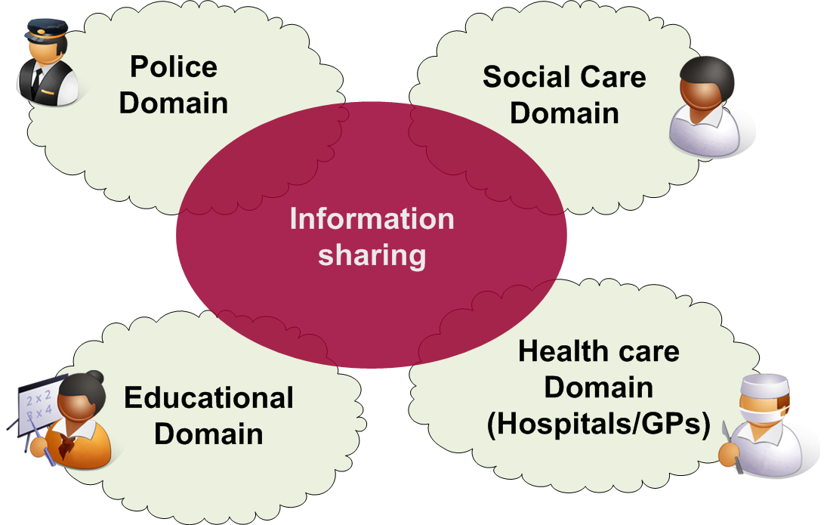
Context – Domain-Based Approach
Notes:
Context:
Need for effective communication between Police and Community Partners: Social Care, Health Care, Education
Firewall-inspired, domain-based structure

Slide 11
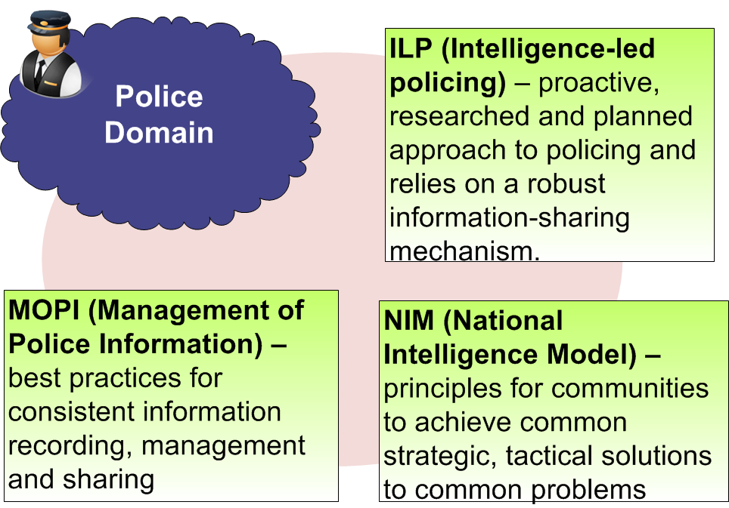
Context – Domain Policy Compliance
. This workshop forms part of research, funded by the Scottish Institute for Policing Research (SIPR), to develop a process for formalising policy using a scientific approach to define information sharing agreements. It aims to critically appraise existing and new methods of policy interpretation, review and implementation, against a relevant example scenario.
Notes:
Context:
Background to Research
From Police Perspective, Key drivers:
ILP
NIM
MoPI - which is of special significance to this research and defines best-practices for information-management in Police Domain
RBAC and domain policies

Slide 12
Aim
Notes:
Achieve Compliance-by-design by creating a novel architecture and policy syntax definition which allows compliant information exchange between partner domains

Slide 13
Architecture
Notes:
Basic Architecture uses Roles Exposed from Domains
Police – Constable, Analyst, Researcher
Healthcare – Doctor, Nurse, Receptionist
SocialCare – Child Protection,Case Worker

Slide 14
Syntax
Notes:
REQUESTER = {Social worker, Doctor, Police Inspector…}.
ATTRIBUTE = {Location, Identity, History, Behaviour, Interaction, Association}.
OBJECT = Any searchable entity about which information is held and which is mapped to a UID within the domain.
CONTEXT = {Crisis, Terrorism, Murder, Missing Person, Child/Adult Protection, Drugs, Volume Crime, Petty Crime, General Request}.
OWNER = {Business Unit 1, Business Unit 2, …}.
TIMERANGE= Definition of time.
RECORDS= {n}.

Slide 15
Overview
Notes:
We are investigating different perspectives in relation to high-level directives, such as Human Rights Act.
High-level policy principles derived from Human Rights Act.
Intermediate formal policy, according to syntax
Low level specific rules enforced by SPoC agents

Slide 16
Compliance by Design

Slide 17
Researchers & Collaborators
Omair Uthmani - Edinburgh Napier
Prof. William Buchanan - Edinburgh Napier
Alistair Lawson - Edinburgh Napier
Ch. Supt. Russell Scott - National Intelligence Model Development Team, Scottish Police College
Prof. Burkhard Schafer - Joseph Bell Centre for Forensic Statistics & Legal Reasoning, Edinburgh University
Alan Small, Programme Manager, Children's Rights and Wellbeing/Positive Futures Teams, Scottish Government
Tabassum Sharif, Director of Operations, Flexiant
Detective Sergeant Joyce Greenhorn, Public Protection Unit, Central Scotland Police

Slide 18
Questions?
Russell Scott
Consultant-3R’s Strategic Management Ltd, Visiting Academic-Napier University
E Mail: R.Scott@napier.ac.uk
Omair Uthmani
Research Student, Centre for Distributed Computing and Security, Edinburgh Napier University
E Mail: O.Uthmani@napier.ac.uk
. This workshop forms part of research, funded by the Scottish Institute for Policing Research (SIPR), to develop a process for formalising policy using a scientific approach to define information sharing agreements. It aims to critically appraise existing and new methods of policy interpretation, review and implementation, against a relevant example scenario.
Notes:
Context:
Need for effective communication between Police and Community Partners: Social Care, Health Care, Education

